Slide 1
Calabash Basics
by Fanglin Liu, 2016-6-7

Slide 2
Outline:
Run Calabash example
Feature (Test) directory structure (overview)
Calabash internals.
Calabash query syntax

Slide 3
Run Calabash example
cucumber -r features features/common
cucumber -r features features/common/conversation.feature
cucumber -r features features/common/conversation.feature:43
https://sqbu-github.cisco.com/WebExSquared/wx2-ios-client/wiki/Developing:-Testing

Slide 4
Feature (Test) directory structure
Feature directory
.feature file
scenarios
step_definitions
Support
Step
Name:
Regular Expression
Body
made up of Calabash Ruby API

Slide 5
Directory structure

Slide 6
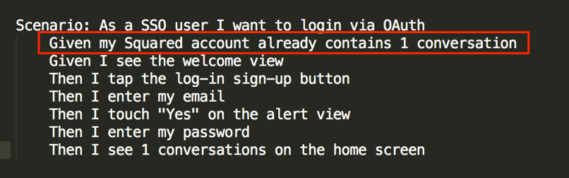
scenario and step definition

Slide 7
Calabash internals

Slide 8
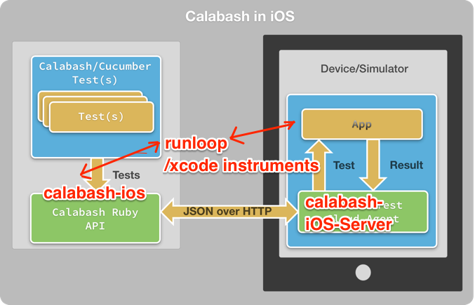

Slide 9
Calabash internals
calabash-ios (calabash-android)
Implement Calabash iOS Ruby API
https://github.com/calabash/calabash-ios
run_loop (android counterpart? )
The bridge between Calabash iOS and Xcode command-line tools like instruments and simctl.
https://github.com/calabash/run_loop
calabash-ios-server
An embedded HTTP server for performing queries and gestures
communicates via JSON over HTTP.
https://github.com/calabash/calabash-ios-server

Slide 10
Calabash internals
Relationship between the 3 components
calabash-ios Implement query and gesture Ruby API based on runloop and calabash-ios-server.
Runloop
Convert Ruby command string to JavaScript API which is exposed by Xcode UIAutomation instrument
run_loop_host.js
calabash-ios-server
Objective-C http server and parse the query and gesture command.
Entry point:
CalabashServer.m

Slide 11
Hands-on Calabash
Experiment on Calabash-ios-example
Define a test scenario
hands on Calabash Ruby API
Query and gesture Ruby API
Backdoor Ruby API
Call methods in AppDelegate class
https://github.com/calabash/calabash-ios-example

Slide 12
Calabash Query Syntax
Query(“view:MyClass”)
Query(“view:UIButton”)
Query(“button”)
view:'MyClass'
"tableViewCell label"
label marked:'Tears in Heaven' parent tableViewCell descendant tableViewCellReorderControl
https://developer.xamarin.com/guides/testcloud/calabash/calabash-query-syntax/
query expressions are a sequence of ClassName expressions.
ClassName expressions

